Slide 1
Russian Translations of Kunwar Narain’s poetry
Translations is a high and difficult art, united by two paradoxical situations: first, translation is impossible, second, every time it is an exception.
S.Ya. Marshak. Poetry of translation
Dr. Guzel Strelkova
Dr. Anastasia Guria
Institute of Asian and African Studies,
Moscow State University.
Moscow, Russia

Slide 2
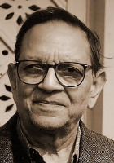
Kunwar Narain (1927-2017)
**
**Photos demonstrated in this presentation are from open sources and a private collection of
Dr. Guzel Strelkova

Slide 3
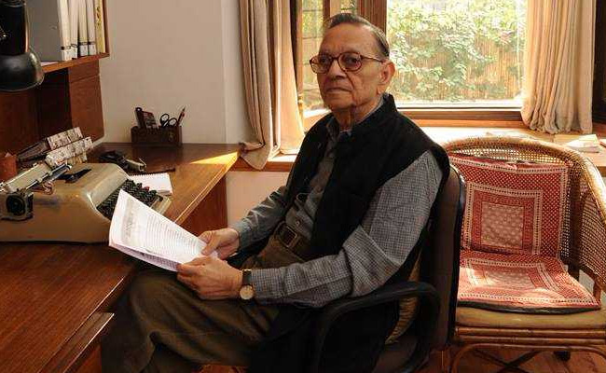
Creations of this Hindi poet and the outstanding writer can not be fixed in the frame of the only one literary school, we can not say that he belongs to exactly this or that literary movement of contemporary Indian literature. Kunwar Narain symbolizes an amalgam of the whole world heritage. We can find reminiscences of different European and Asian writers, including Nazim Hikmet or Borges or Kafka with his paradoxes and absurd situations a reader find in his stories. The poetry of Kunwar Narain is unique, and this paper concentrates on the Russian translations of his poetry, included in several collections.

Slide 4
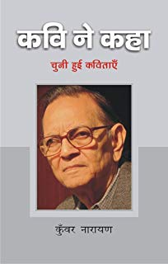
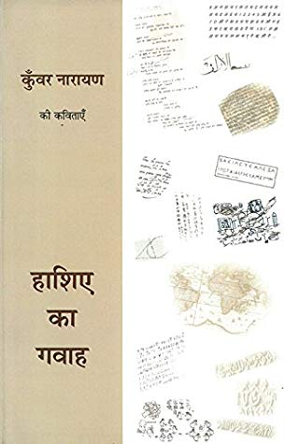
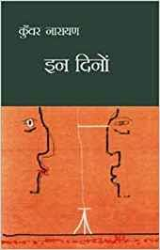
Kunwar Narain
“In these days”
Kunwar Narain
“The Poet said”
Selected poems

Slide 5
Translations into English some of poems of Kunwar Narain

Slide 6
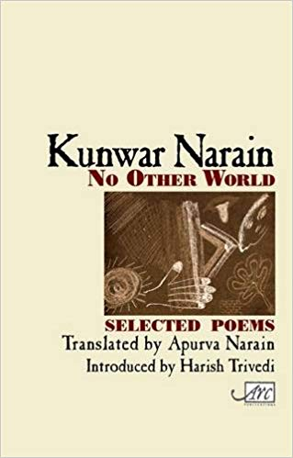
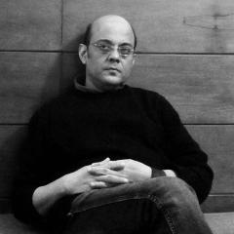
Kunwar Narain. No other world, Selected poems, Rupa&Co, New Delhi, 2008
“It is in this light too that I have largely not followed any translation theory.
I have kept to my instincts and hoped
that some of this poetic journey may have shaped those instincts too”.

Slide 7
Translations into Russian
Kunwar Narain
Tsvety dereva neem.
“U Nikitskih vorot” Publishing House”
Moscow, 2014
Translated into Russian by
Guzel Strelkova and Anastasia Guria

Slide 8
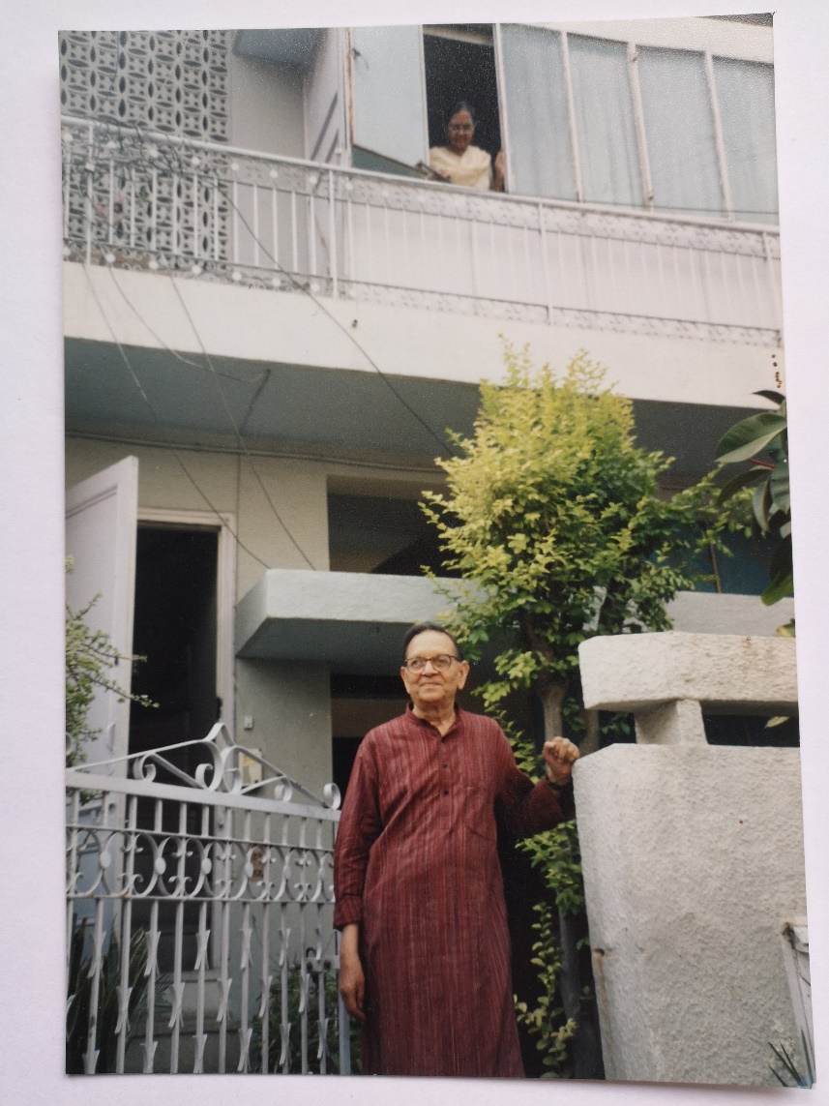
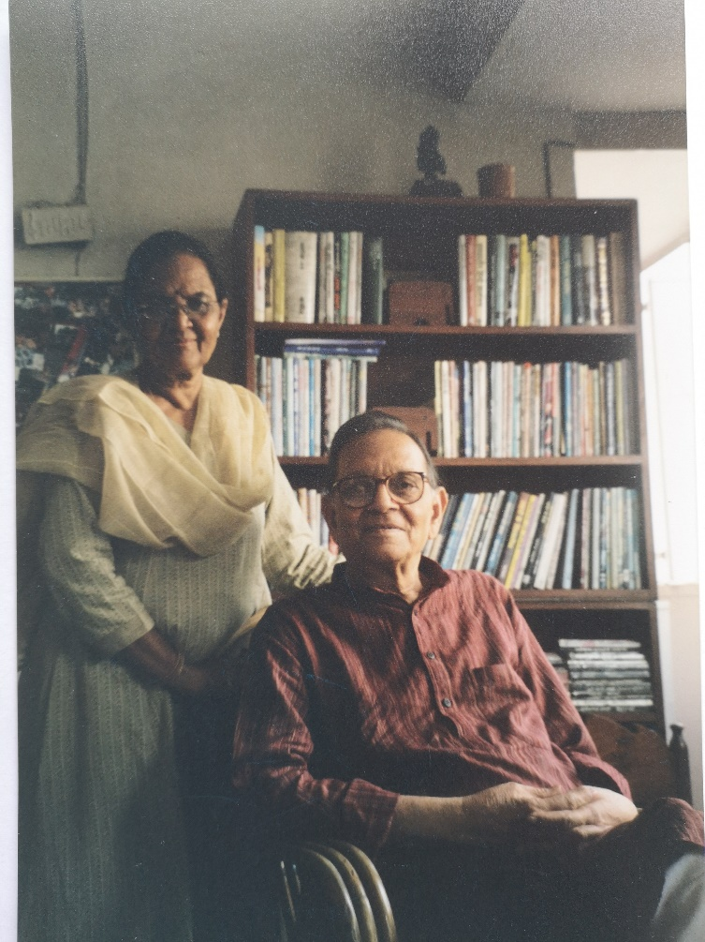
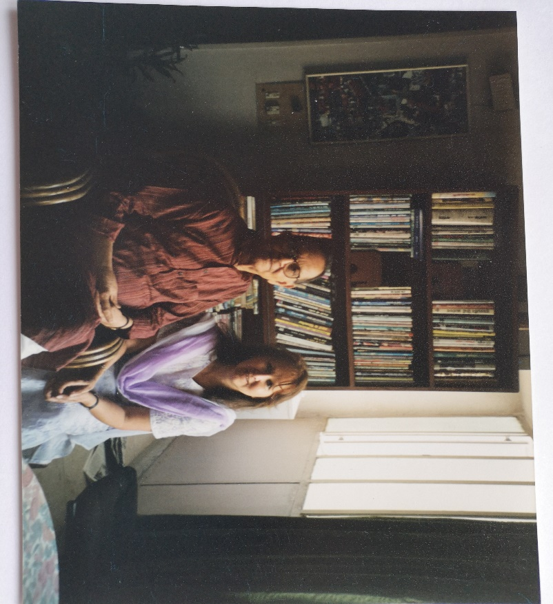
My first meeting with Kunwar Narain in 2004

Slide 9
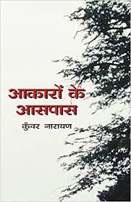
Some of poetry collections of Kunwar Narain, on the basis of which Russian translation of his poetry was fulfilled

Slide 10
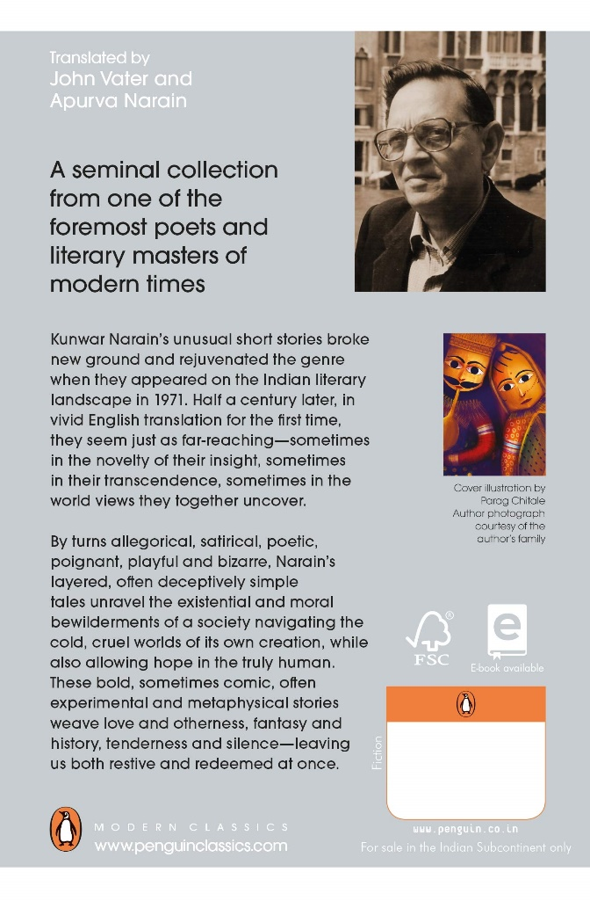
An English translation of Kunwar Narain collection of stories “Akaaron kaa aaspaas”

Slide 11
Kunwar Narain Neem ke phul Flowers of Neem
Tsvety nimaa
Terpko-sladkim aromatom lekarstva
Napolnyalsya dom
Kogda vo dvore na dereve nim tsvety poyavlyalis’
Slovno mylnye puzyrki
V vozduhe letyaschiye melkie-melkie tsvetochki
Odin - dva v maminyh volosah putalis’
Kogda ona, poliv kustik tulsi,
So dvora vozvrashalas’.
Flowers of Neeml
With a bitter-sweet smell of medicine
The house filled up
When in the yard on the Neem tree flowers appeared
Like small soap bubbles
In the air flying tiny – tiny white flowers.
One or two in mother’s hair entangled
When she after watering a small bush of tulsi
Was returning from the court

Slide 12
Kunwar Narain Neem ke phul
Tsvety nimaa
Udivitel’no, kogda by ob etih tsvetah ne dumal,
Dumal o nih vo mnojestvenom chisle
Ni razu ne videl ih uvyadaniya – i tak je
V polnom tsvetenii ih ne vidal nikogda
Tak, kak videl gulmohar or kachnar – no bylo
V tom, kak osypalis’ oni, daje bolee, chem v tsvetenii chto-to
Krotkoye polnoe dostoinstva, chto ne bylo ni radostyu,
ni sojaleniyem.
Flowers of the Neem tree
Strange, whenever I thought of these flowers,
Thought of them in plural.
Never saw them withering – and also
Never saw them in full bloom
As I saw gulmohar or kachnar – yet there was
in their withering, even more than in their blossoming, something
serene and dignified, which was neither joy
nor remorse.

Slide 13
Kunwar Narain Neem ke phul
Tsvety nimaa
Na pamyat’ prihodit pod derevom dlya vseh
Vsegda prigotovlennye
Neskol’ko polovichkov: igrayuschee butonami nima detstvo…
Na pamyt’ prihodit na polojennoe pod nimom
Zemnoe telo otsa
Skromnyh tsvetov teh otreshennyj potok –
slovno struilsya on s maminyh volos – malen’kih – melkih tsvetochkov,
Chto ne slezami – uteshenyem kazalis.’
Flowers of the Neem tree
Comes to mind under the tree for everybody
Always prepared
a few rugs: playing with neem buds childhood.
Comes to mind on the put under Neem
the father’s earthy body
Of that modest flowers detached stream
As if it flowed from mum’s hair – small-small flowers
That not tiers but consolation seemed

