Slide 1

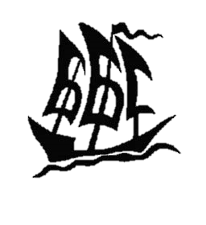

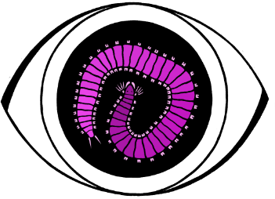
Sponge Сell Reaggregation: Inter- and Intraspecific Variations
Lomonosov Moscow State University, Moscow, Russia
Andrey I. Lavrov
White Sea Biological Station, MSU
Igor A. Kosevich
Dept. Invertebrate Zoology, MSU

Slide 2
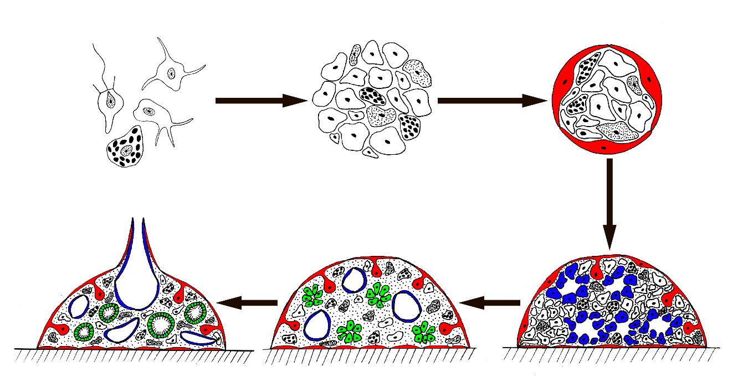
Sponge cell reaggregation
1) Sponge cells have ability to reaggregation after animal tissue dissociation due to overall flexibility of sponge tissues;
2) Multicellular aggregates differing in structure are formed during cell reaggregation and in certain cases full reconstruction of functional and viable sponge occurs;
3) The multicellular aggregates formation and development is not a result of the assemblage and sorting of initially differentiated cells, but instead involves active cell dedifferentiations and transdifferentiations.
Primmorphs
Cell suspension
Primary aggregates
Reconstruction of intact structure of the sponge

Slide 3
Studied species
Leucosolenia complicata (кл. Calcarea)
Haliclona aquaeductus (кл. Demospongiae)
Halichondria panicea (кл. Demospongiae)
Halisarca dujardinii (кл. Demospongiae)

Slide 4
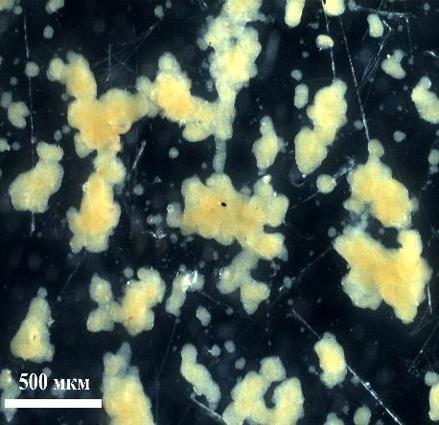
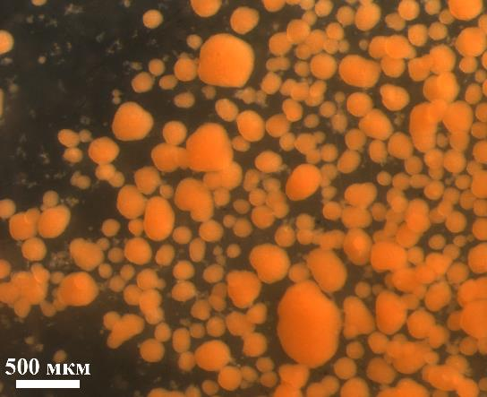
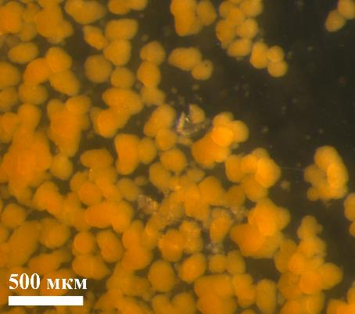
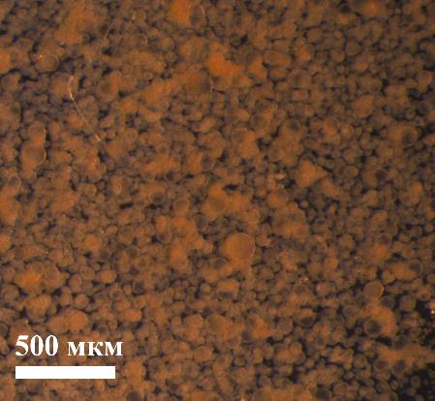
Primary multicellular aggregates
The typical size is 100-300 µm.
The shape is various - from round to complex branching.
The surface is rough. Aggregates have no surface epithelium.
Aggregates have no internal structure.
500 µm
500 µm
H. dujardinii (1 hpd)
H. aquaeductus (24 hpd)
500 µm
500 µm
H. panicea (24 hpd)
L. complicata (24 hpd)
hpd – hours post dissociation

Slide 5
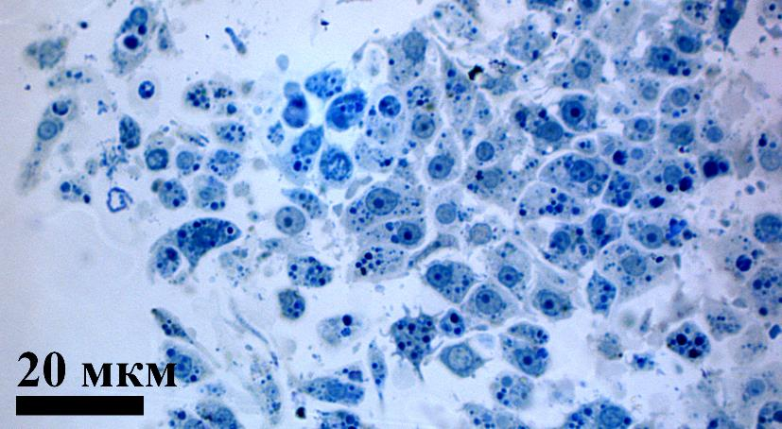
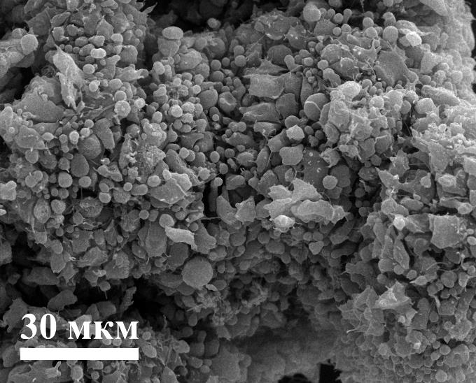
Primary multicellular aggregates
The typical size is 100-300 µm.
The shape is various - from round to complex branching.
The surface is rough. Aggregates have no surface epithelium.
Aggregates have no internal structure.
20 µm
30 µm

Slide 6
1 Cell suspension
2 Primary aggregates
Developmental stop-point 1
(8 sp)
Original data
Literature data
sp - species

Slide 7
1 Cell suspension
2 Primary aggregates
Developmental stop-point 1
(8 sp)
3. Primmorphs
3.1 Early-staged primmorphs
3.2 True primmorphs
Original data
Literature data
sp - species

Slide 8
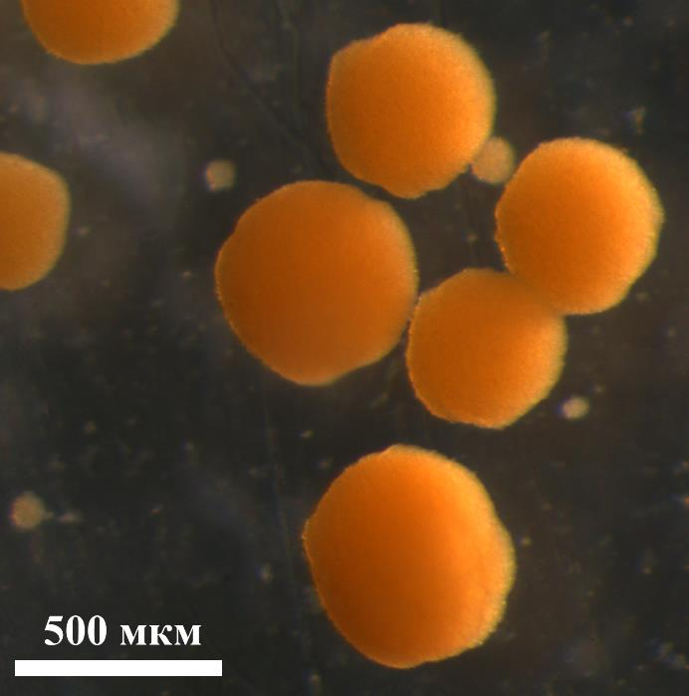
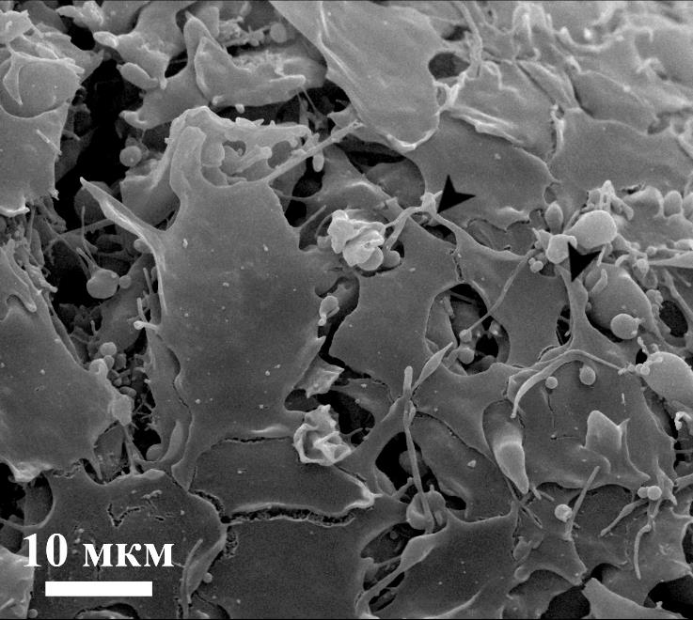
Early-staged primmorphs
The shape is almost spherical, but surface is rough
The epithelization begins - few exopinacocytes are scattered on the surface
500 µm
H. panicea early-staged
primmorphs
10 µm
Exopinacocytes on the surface of H. dujardinii early-staged primmorph

Slide 9
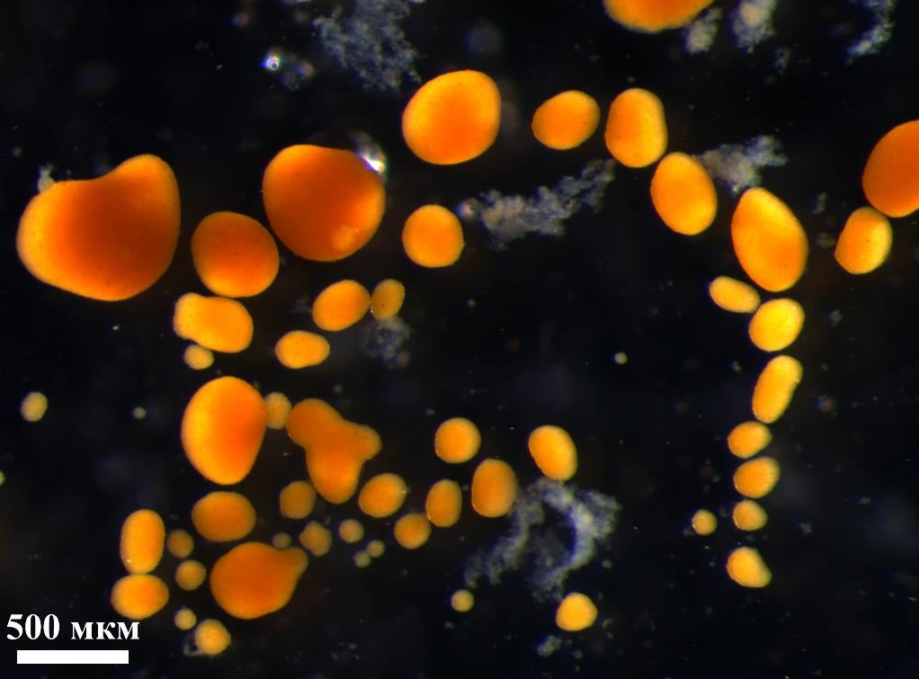
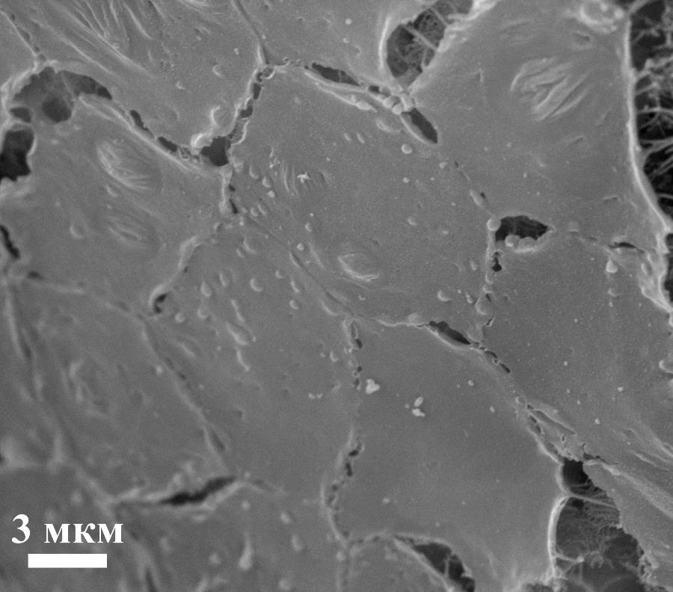
True primmorphs
These aggregates have continuous layer of the exopinacocytes on their surface
500 µm
3 µm
H. panicea true primmorphs
Exopinacoderm of H. dujardnii true primmorphs

Slide 10
1 Cell suspension
2 Primary aggregates
Developmental stop-point 1
(8 sp)
3. Primmorphs
3.1 Early-staged primmorphs
3.2 True primmorphs
3+32 sp forms primmorphs during cell reaggregation
Original data
Literature data
sp - species

Slide 11
1 Cell suspension
a. Rapid formation (3+22 sp) 3-10 dpd
2 Primary aggregates
Developmental stop-point 1
(8 sp)
Valisano et al., 2006
3. Primmorphs
3.1 Early-staged primmorphs
3.2 True primmorphs
Original data
Literature data
sp – species
dpd – days post dissociation

Slide 12
1 Cell suspension
a. Rapid formation (3+22 sp) 3-10 dpd
b. Slow formation (3 sp) >15 dpd
2 Primary aggregates
Developmental stop-point 1
(8 sp)
Valisano et al., 2006
3. Primmorphs
3.1 Early-staged primmorphs
3.2 True primmorphs
Original data
Literature data
sp – species
dpd – days post dissociation

Slide 13
1 Cell suspension
a. Rapid formation (3+22 sp) 3-10 dpd
b. Slow formation (3 sp) >15 dpd
c. Extrarapid formation (1+7 sp) <2 dpd
2 Primary aggregates
Developmental stop-point 1
(8 sp)
3. Primmorphs
3.1 Early-staged primmorphs
3.2 True primmorphs
Original data
Literature data
sp – species
dpd – days post dissociation

Slide 14
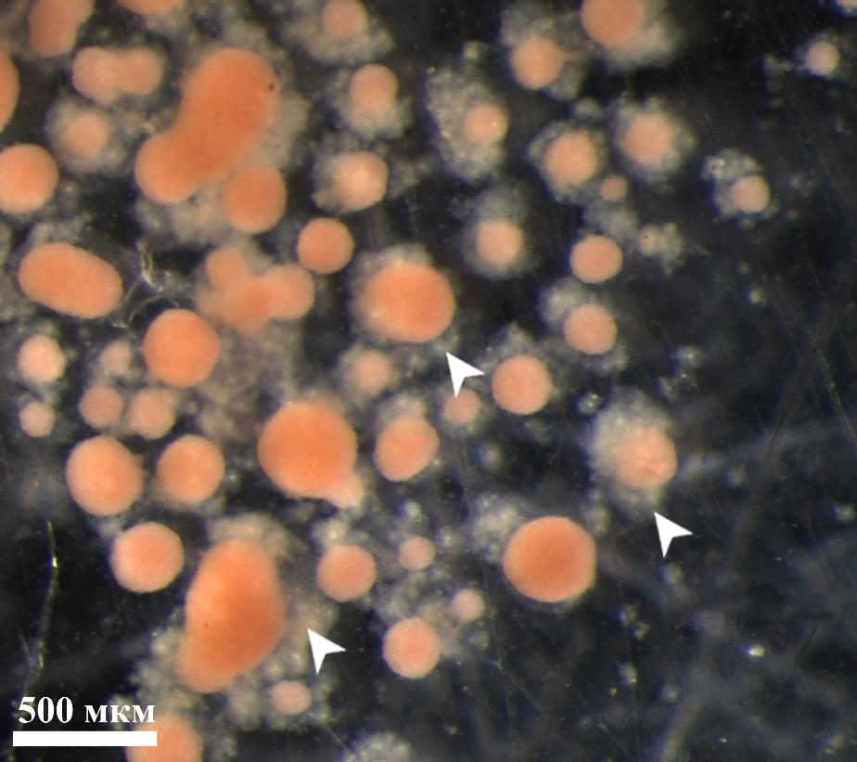
Transformation to primmorphs
H. panicea and H. aquaeductus
Transformation starts at 3 dpd.
The envelope consisting of dead cells and cell debris forms around the transforming aggregates.
Transformation is accompanied by the changes in cell composition: primmorphs of these species consist mainly of nucleolar amoebocytes.
500 µm
H. aquaeductus aggregates during transformation to the primmorphs
dpd – days post dissociation

Slide 15
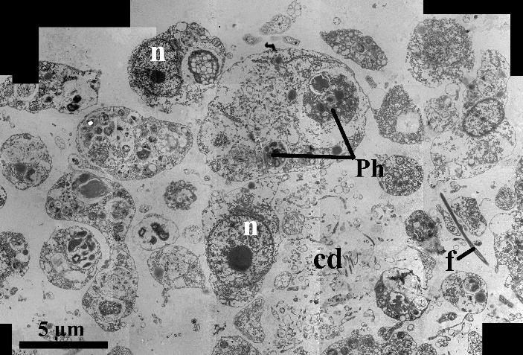
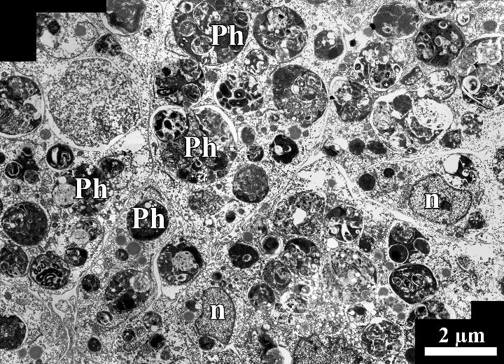
Transformation to primmorphs
H. panicea and H. aquaeductus
Transformation starts at 3 dpd.
The envelope consisting of dead cells and cell debris forms around the transforming aggregates.
Transformation is accompanied by the changes in cell composition: primmorphs of these species consist mainly of nucleolar amoebocytes.
Structure of H. panicea primary aggregates
dpd – days post dissociation
Structure of H. panicea primmorphs

Slide 16
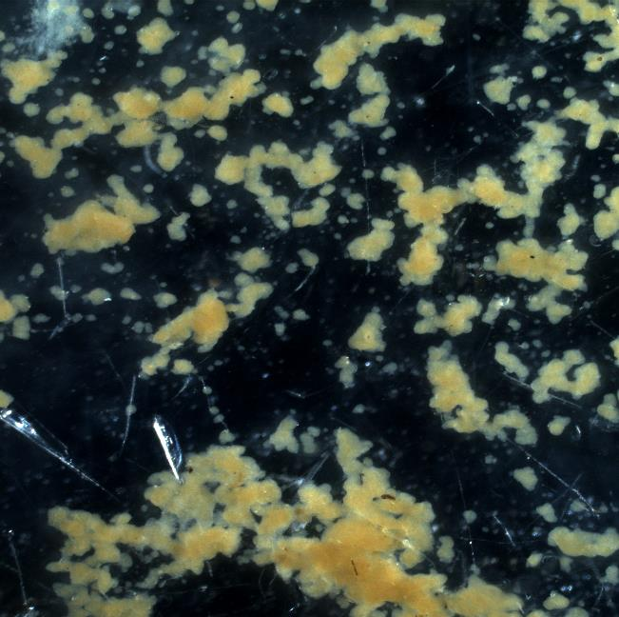
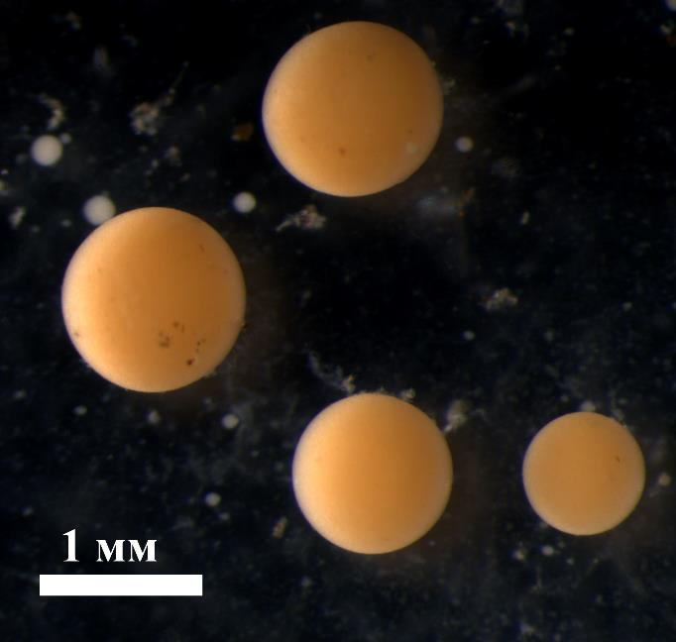
Transformation to primmorphs
H. dujardinii and L. complicata
Transformation is not accompanied by the formation of the envelope around transforming aggregates and changes of their cell composition.
1 mm
H. dujardinii primary aggregates
H. dujardinii primmorphs

Slide 17
1 Cell suspension
a. Rapid formation (3+22 sp) 3-10 dpd
b. Slow formation (3 sp) >15 dpd
c. Extrarapid formation (1+7 sp) <2 dpd
2 Primary aggregates
Developmental stop-point 1
(8 sp)
3. Primmorphs
3.1 Early-staged primmorphs
3.2 True primmorphs
a. With alteration of cell composition (2+1 sp)
b. Without alteration of cell composition (2+31? sp)
Original data
Literature data
sp – species
dpd – days post dissociation

Slide 18
1 Cell suspension
a. Rapid formation (3+22 sp) 3-10 dpd
b. Slow formation (3 sp) >15 dpd
c. Extrarapid formation (1+7 sp) <2 dpd
2 Primary aggregates
Developmental stop-point 1
(8 sp)
3. Primmorphs
3.1 Early-staged primmorphs
3.2 True primmorphs
a. With alteration of cell composition (2+1 sp)
b. Without alteration of cell composition (2+31? sp)
Developmental stop-point 2
(3+25 sp)
Original data
Literature data
sp – species
dpd – days post dissociation

Slide 19
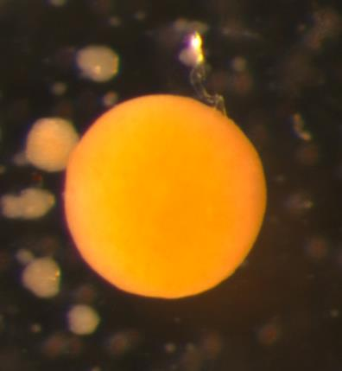
Progressive development of H. dujardinii primmorphs
Primmorph

Slide 20
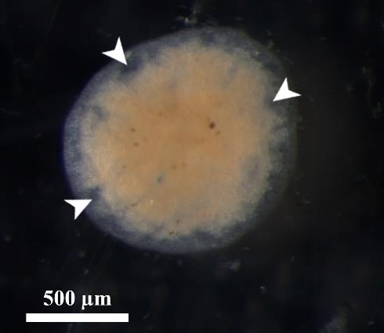
Progressive development of H. dujardinii primmorphs
Primmorph
Attachment to the substrate and aquiferous system development

Slide 21
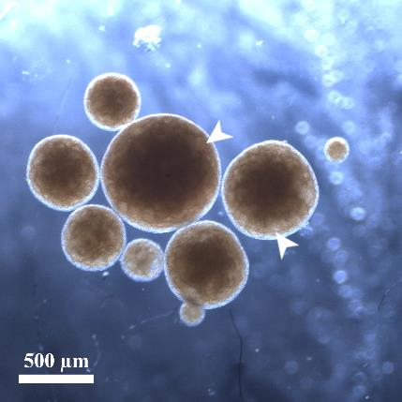
Progressive development of H. dujardinii primmorphs
Primmorph
Attachment to the substrate and aquiferous system development

Slide 22
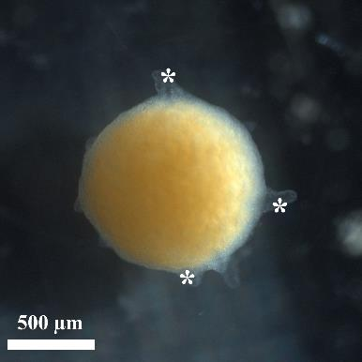
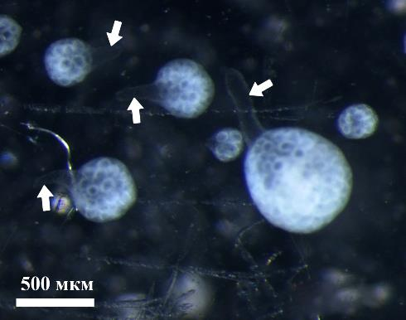
Progressive development of H. dujardinii primmorphs
Primmorph
Attachment to the substrate and aquiferous system development
Osculum rudiments
Reconstructed sponges

Slide 23
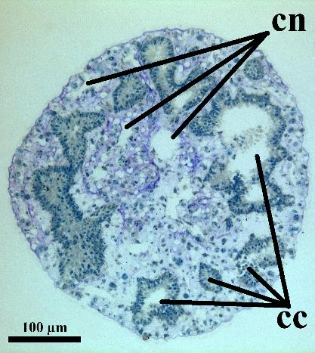
Progressive development of H. dujardinii primmorphs
Primmorph
Attachment to the substrate and aquiferous system development
Osculum rudiments
Reconstructed sponges

Slide 24
1 Cell suspension
a. Rapid formation (3+22 sp)
b. Slow formation (3 sp)
c. Extrarapid formation (1+7 sp)
2 Primary aggregates
Developmental stop-point 1
(8 sp)
3. Primmorphs
3.1 Early-staged primmorphs
3.2 True primmorphs
a. With alteration of cell composition (2+1 sp)
b. Without alteration of cell composition (2+31? sp)
Developmental stop-point 2
(3+25 sp)
4 Developing primmorphs
4.1 Attachment to the substrate
4.2 Aquiferous system development
4.3 Formation and opening of osculums
Original data
Literature data
sp - species
Sponge reconstruction
(1+7 sp)

Slide 25
Description of cell reaggregation process
1. L. complicata – rapid primmorph formation without changes in cell composition, final stage of the cell reaggregation – true primmorphs.

Slide 26
Description of cell reaggregation process
1. L. complicata – rapid primmorph formation without changes in cell composition, final stage of the cell reaggregation – true primmorphs.
2. H. panicea and H. aquaeductus – rapid primmorph formation with changes in cell composition, final stage of the cell reaggregation – true primmorphs.

Slide 27
Description of cell reaggregation process
1. L. complicata – rapid primmorph formation without changes in cell composition, final stage of the cell reaggregation – true primmorphs.
2. H. panicea and H. aquaeductus – rapid primmorph formation with changes in cell composition, final stage of the cell reaggregation – true primmorphs.
3. H. dujardinii – extrarapid primmorph formation without changes in cell composition, final stage of the cell reaggregation – intact sponge.

Slide 28
Final stage of cell reaggregation in H. panicea
Primary aggregates – Eerkes-Medrano et al., 2015
Primmorphs – Yazykov, 1965; Sipkema et al., 2003; Lavrov, Kosevich, 2016
Intact sponge – Korotkova, 1972
The same is known for some other sponge species

Slide 29
Intraspecific variations of cell reaggregation
We supposed that the differences in the physiological state and structure of somatic tissue of individuals used by different researchers could be the reason of the intraspecific variations.

Slide 30
Intraspecific variations of cell reaggregation
We supposed that the differences in the physiological state and structure of somatic tissue of individuals used by different researchers could be the reason of the intraspecific variations.
In sponges the dramatic changes of the physiological state and structure of somatic tissue occurs during their life and reproduction cycles, as well as during annual cycle.

Slide 31
Intraspecific variations of cell reaggregation
We supposed that the differences in the physiological state and structure of somatic tissue of individuals used by different researchers could be the reason of the intraspecific variations.
In sponges the dramatic changes of the physiological state and structure of somatic tissue occurs during their life and reproduction cycles, as well as during annual cycle.
To examine how the reproduction status of individual used for experiments influence the cell reaggregation, we conduct the series of experiments with Halichondria panicea and Halisarca dujardinii at different stages of their reproduction cycles.

Slide 32
Intraspecific variations. Experimental scheme
 | Nonreproducing individuals | Individuals with gametes | Individuals with embryos/larvae | Individuals after the larvae release

Slide 33
Intraspecific variations. Experimental scheme
 | Nonreproducing individuals | Individuals with gametes | Individuals with embryos/larvae | Individuals after the larvae release
Final stage of the process
Formation time of the final stage
Proportion of the cultures with the most progressive stage known for species
dpd – days post dissociation

Slide 34
Intraspecific variations in H. dujardinii cell reaggregation
 | Nonreproducing individuals | Individuals with gametes | Individuals with embryos/larvae | Individuals after the larvae release
Final stage of the process | Intact sponge | Intact sponge | Intact sponge | Intact sponge
Formation time of the final stage | 10-13 dpd | 11-12 dpd | 18 dpd | 18 dpd
Proportion of the cultures with reconstructed sponges | 100% | 78% | 33% | 9%
dpd – days post dissociation

Slide 35
Intraspecific variations in H. panicea cell reaggregation
 | Nonreproducing individuals | Individuals with gametes | Individuals with embryos/larvae | Individuals after the larvae release
Final stage of the process | True primmorphs | True primmorphs | Early-staged primmorphs | Primary aggregates
Formation time of the final stage | 5 dpd | 7-9 dpd | 4-6 dpd | 1 dpd
Proportion of the cultures with true primmorphs | 40% | 80% | 0% | 0%
dpd – days post dissociation

Slide 36
Conclusion
Sponge cell reaggregation is a good model system for studying the sponge tissue functioning. However, the great interspecific variations complicate the analysis of the process. Our results show that observed intraspecific variations are at least partially the result of the intraspecific variations, what means that before making any comparisons between cell reaggregation in different species we should fully reveal and understand the morphogenetic potencies of the cells and multicellular aggregates by studying the process at different stages of species life and reproductive cycles. Only such approach will allow us to produce the consistent scheme of sponge cell reaggregation.

Slide 37

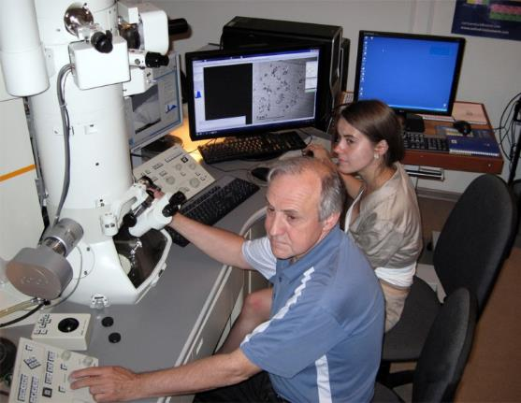
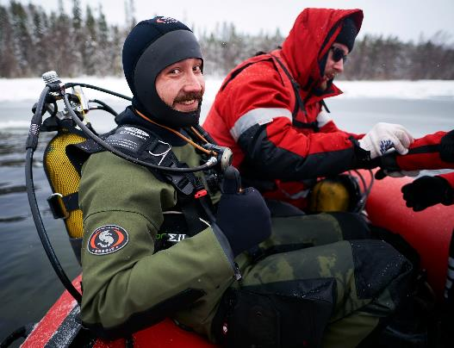

Thank you for your attention!
Acknowledgments
Technical staff of Electron Microscopy Laboratory of the Shared Facilities Center MSU
for assistance with electron microscopy studies
SCUBA divers of WSBS MSU
for assistance in sponge collection
Dr. A. Tzetlin,
the director of WSBS MSU
The study was supported by the Russian Foundation of Basic Research (project no. 16-34-00145).

Slide 38
Studied material
Species | Number of individuals | Number of cell cultures
Leucosolenia complicata | 24 | 32
Haliclona aquaeductus | 8 | 47
Halichondria panicea | 40 | 208
Halisarca dujardinii | 43 | 127
Total | 115 | 414

Slide 39
Studied material
 | Nonreproducing individuals | Individuals with gametes | Individuals with embryos/larvae | Individuals after the larvae release
H. panicea | 5 | 15 | 10 | 10
H. dujardinii | 17 | 9 | 6 | 11

